Slide 1
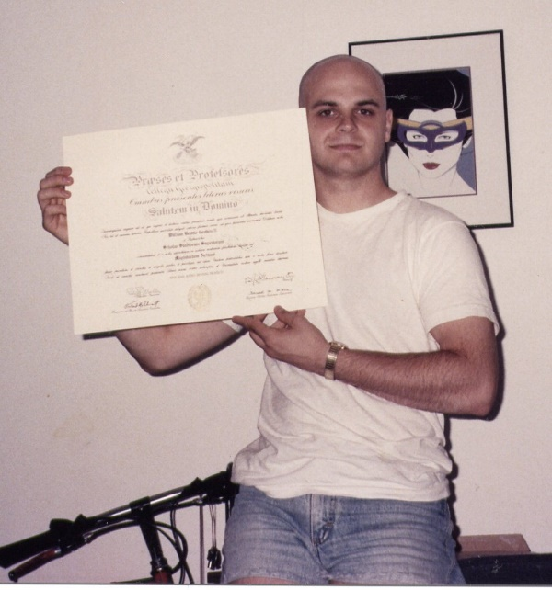

Slide 2
Leviticus 18.1-4 NET: The LORD spoke to Moses: “Speak to the Israelites and tell them, ‘I am the LORD your God! You must not do as they do in the land of Egypt where you have been living, and you must not do as they do in the land of Canaan into which I am about to bring you; you must not walk in their statutes. You must observe my regulations and you must be sure to walk in my statutes. I am the LORD your God.’”
Live God’s way, not the world’s way
Leviticus 18.24-30: similar warnings.

Slide 3
18.1-5: Live God’s way, not the world’s way
18.6-23: application about sexuality
18.24-30: Live God’s way, not the world’s way
18.9 NET: You must not have sexual intercourse with your sister.

Slide 4
18.1-5: Live God’s way, not the world’s way
18.6-23: application about sexuality
18.24-30: Live God’s way, not the world’s way
18.9 NET: You must not have sexual intercourse with your sister.
18.22 NET: You must not have sexual intercourse
with a male as one has sexual intercourse
with a woman; it is a detestable act.
שָׁכַב = to lie down

Slide 5
Leviticus 18.22 NET: You must not have sexual intercourse with a male as one has sexual intercourse
with a woman; it is a detestable act.
Leviticus 20.13 NET: If a man has sexual intercourse with a male as one has sexual intercourse with a woman, the two of them have committed an abomination…

Slide 6
Is Leviticus relevant today?
18.1-5: Live God’s way, not the world’s way
18.6-23: application about sexuality
18.24-30: Live God’s way, not the world’s way
18.9 NET: You must not have sexual intercourse with your sister.
18.22 NET: You must not have sexual intercourse
with a male as one has sexual intercourse
with a woman; it is a detestable act.

Slide 7
1 Corinthians 6.9-10 NET: Do you not know that the unrighteous will not inherit the kingdom of God? Do not be deceived! The sexually immoral, idolaters, adulterers, passive homosexual partners, practicing homosexuals, thieves, the greedy, drunkards, the verbally abusive, and swindlers will not inherit the kingdom of God.
μαλακός & ἀρσενοκοίτης = passive and active men engaged in homosexual behavior

Slide 8
Romans 1.15-17 begins the argument
that all people need salvation from sin.
Romans 1.18 NET: …the wrath of God is revealed from heaven against all ungodliness…
Romans 1.19-25: people have turned
away from God to believe false ideas,
worship false gods, serve created things.

Slide 9
Romans 1.26-28 NET: For this reason God gave them over to dishonorable passions. For their women exchanged the natural sexual relations for unnatural ones, and likewise the men also abandoned natural relations with women and were inflamed in their passions for one another. Men committed shameless acts with men and received in themselves the due penalty for their error. And just as they did not see fit to acknowledge God, God gave them over to a depraved mind, to do what should not be done.

Slide 10
Romans 1.26-28 NET: For this reason God gave them over to dishonorable passions. For their women exchanged the natural sexual relations for unnatural ones, and likewise the men also abandoned natural relations with women and were inflamed in their passions for one another. Men committed shameless acts with men and received in themselves the due penalty for their error. And just as they did not see fit to acknowledge God, God gave them over to a depraved mind, to do what should not be done.

Slide 11
Grace Forgiveness
Grace License to sin
Grace Intimacy with God
Grace Turning away to the world
NOT
NOT

Slide 12
Love Righteousness/Holiness
Love Corruption/Sin
Love Transformation
NOT

Slide 13
Genesis 1.27-28 NET: God created humankind in his own image, in the image of God he created them, male and female he created them. God blessed them and said to them, “Be fruitful and multiply! Fill the earth and subdue it! Rule over the fish of the sea and the birds of the air and every creature that moves on the ground.”
Our purpose: reflect God’s character,
represent God here,
multiply the image of God

Slide 14
Genesis 2.18 NET: The LORD God said, “It is not good for the man to be alone. I will make a companion for him who corresponds to him.”
עֵזֶר = help
נֶגֶד = opposite and complementary

Slide 15
Genesis 2.21-24 NET: So the LORD God caused the man to fall into a deep sleep, and while he was asleep, he took part of the man's side and closed up the place with flesh. Then the LORD God made a woman from the part he had taken out of the man, and he brought her to the man. Then the man said, “This one at last is bone of my bones and flesh of my flesh; this one will be called ‘woman,’ for she was taken out of man.” That is why a man leaves his father and mother and unites with his wife, and they become a new family.
לְבָשָׂ֥ר אֶחָֽד = one flesh

Slide 16
Genesis 2.18 NET: The LORD God said, “It is not good for the man to be alone. I will make a companion for him who corresponds to him.”
עֵזֶר = help
נֶגֶד = opposite and complementary
Genesis 2.24 NET: That is why a man leaves his father and mother and unites with his wife, and they become a new family.
לְבָשָׂ֥ר אֶחָֽד = one flesh

Slide 17
Sinful tendencies can arise from three sources:
our own corrupted human nature
our experiences in a fallen world
demonic influence

Slide 18
Individual response to homosexual desires:
1. Believe in Jesus as your savior
experience redemption [freedom from sin]
experience sanctification [purification]
2. Submit to Jesus as your Lord
find your identity and validation in him
experience new spiritual life
3. Accept God’s grace and forgiveness
live without shame
walk in God’s light
4. Immerse yourself in Christian community

Slide 19
Church response to homosexuality:
1. Love the sinner
don’t judge them, just their sin
welcome them into our church
mediate God’s love, grace, and truth to them
2. Resist cultural deterioration
speak truth in love about sin and salvation
resist legal & cultural shifts toward immorality
3. Remember our mission to share the gospel

